Slide 1
The Battle of neighbourhoods
New restaurant in Berlin, Germany
Author - Sabarinadh

Slide 2
Table of contents
Introduction Section
The “Business Problem” for the project team to address the problem
Methodology Selection
Execute data processing, Data Analysis, Machine Learning used
Results
Discussion
Conclusion

Slide 3
Introduction Section
Alexanderplatz, Berlin location in Germany for review
Optimum location for new restaurant business
Business Problem –
Choice of neighborhood to start the new restaurant – Italian cuisine in Alexandra platz
Low competition
High demand
Choice of menu
Success Criteria –
Neighborhood addressing the business problem

Slide 4
Introductory section Data Gathering…
Creating a grid area around 6KM in from Alexanderplatz would visualize the existing restaurants/ hotels
Designated neighbour hood will be defined as circular areas with a radius of 300 meters, so our neighbour hood centre will be 600 meters apart
To accurately calculate distances we need to create our grid of locations in Cartesian 2D coordinate system which allows us to calculate distances in meters (not in latitude/longitude degrees). Then we'll project those coordinates back to latitude/longitude degrees to be shown on Folium map. So let's create functions to convert between WGS84 spherical coordinate system (latitude/longitude degrees) and UTM Cartesian coordinate system (X/Y coordinates in meters)

Slide 5
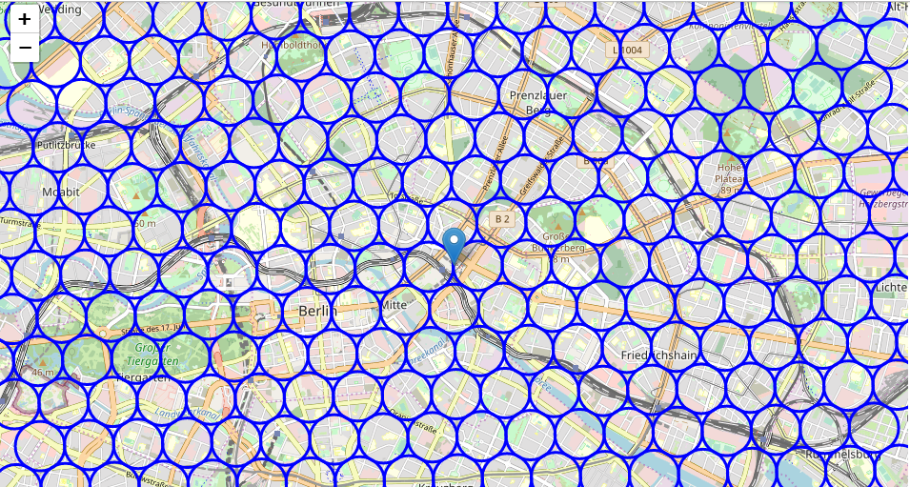
Continues..
Neighbor hoods within 6KM distance from Alexanderplatz, Berling as below

Slide 6
Continues..
Use Google maps API to get the address of the appropriate location
Use Foursquare API to get info on restaurants in each neighbor hood
Filter only the restaurants which are with Italian cuisine
Pick all the Italian restaurants with in 6KM’s from Alexanderplatz and identifying the exact vicinity of the restaurants in the neighborhood

Slide 7
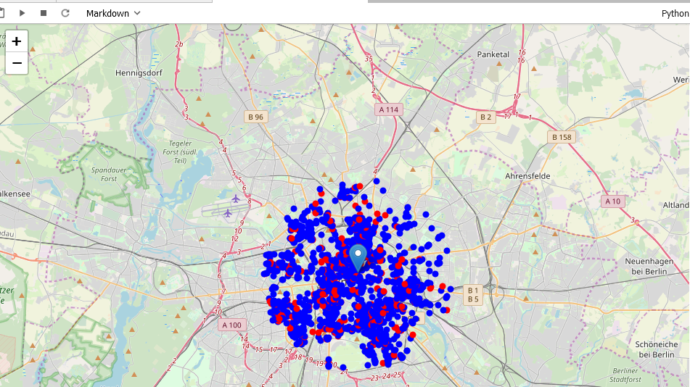
Continues..
Italian cuisine restaurant with BLUE color and the rest are with blue colour

Slide 8
Methodology Selection
In this project we will direct our efforts on detecting areas of Berlin that have low restaurant density, particularly those with low number of Italian restaurants. We will limit our analysis to area ~6km around city centre.
First step collect the required data: location and type (category) of every restaurant within 6km from Berlin centre (Alexanderplatz) and identify Italian restaurants using Foursquare categorization.
Second step Calculation and exploration of restaurant density across different areas of Berlin - Use heatmaps to identify a few promising areas close to centre with low number of restaurants in general (and no Italian restaurants in vicinity) and focus our attention on those areas.
Third step Focus on most promising areas and within those create clusters of locations that meet some basic requirements established in discussion with stakeholders. Considering the locations with not more than 2 restaurants in radius of 250 meters and locations without Italian restaurants in radius of 400 meters. Publishing the map of all such locations but also create clusters (using k-means clustering) of those locations to identify general zones / neighbourhoods / addresses which should be a starting point for final 'street level' exploration and search for optimal venue location by stakeholders.

Slide 9
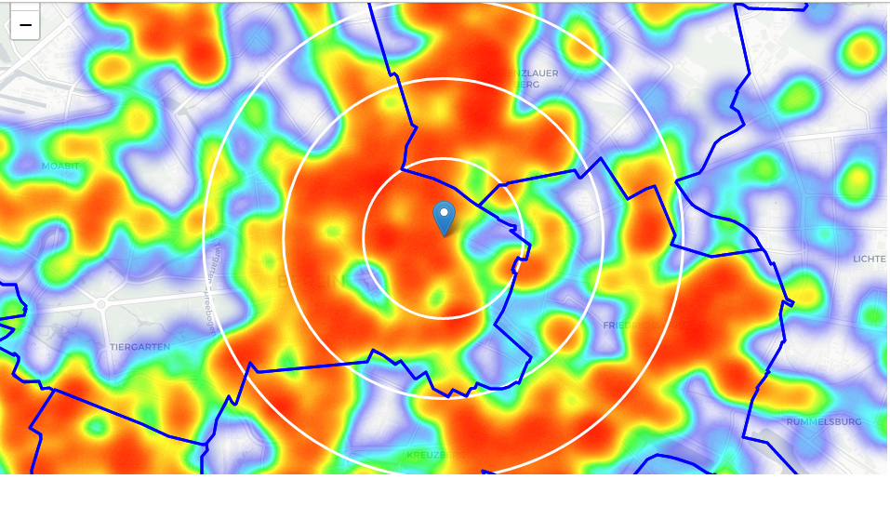
Cont.. Graphical Coordinates of data
Average Italian restaurant can be found within ~500m from every area centre candidate. That's fairly close, so we need to filter our areas carefully!
Let's create a map showing heatmap / density of restaurants and try to extract some meaningful info from that. Also, let's show borders of Berlin boroughs on our map and a few circles indicating distance of 1km, 2km and 3km from Alexanderplatz.

Slide 10
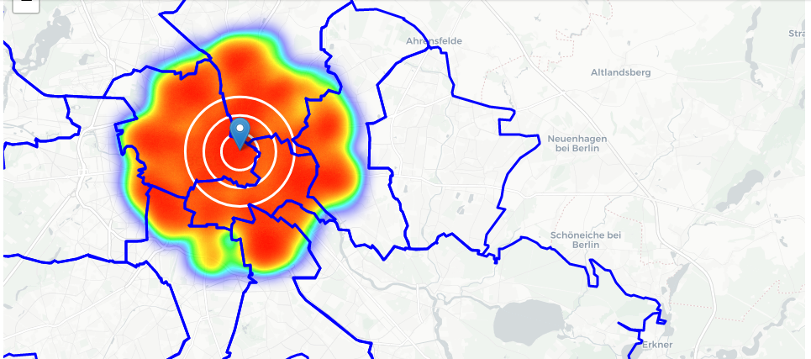
Cont.. Graphical Coordinates of data
Below heatmap showing the density of restaurants.
Borders of Berlin boroughs on the below map and a few circles indicating distance of 1km, 2km and 3km from Alexanderplatz

Slide 11
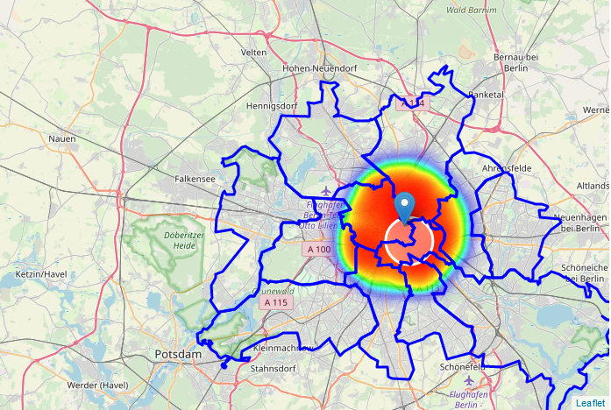
Cont.. Graphical Coordinates of data
Narrow the region of interest, which will include low-restaurant-count parts of Kreuzberg and Friedrichshain closest to Alexanderplatz

Slide 12
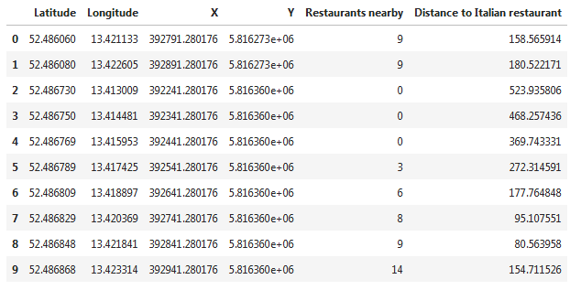
Cont.. Instance of data
Number of restaurants in vicinity with in the radius of 250 meters and distance to closest Italian restaurant

Slide 13
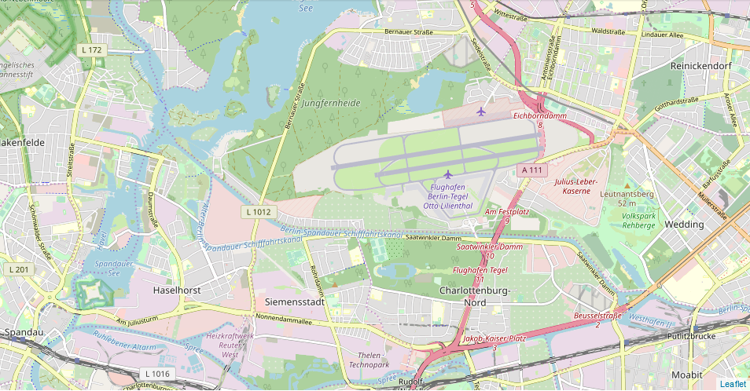
Results
Created 15 addresses representing centres of zones containing locations with low number of restaurants and no Italian restaurants nearby, all zones being fairly close to city centre (all less than 4km from Alexanderplazt, and about half of those less than 2km from Alexanderplatz). Although zones are shown on map with a radius of ~500 meters (green circles), their shape is actually very irregular and their centres/addresses should be considered only as a starting point for exploring area neighborhoods in search for potential restaurant locations. Most of the zones are located in Kreuzberg and Friedrichshain boroughs, which we have identified as interesting due to being popular with tourists, fairly close to city centre and well connected by public transport.

Slide 14
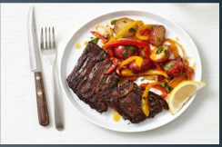
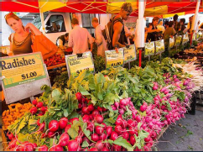
Discussion
Scope to explore cuisines of various cities in Berlin, Germany
In Alexanderplatz, cuisines of many countries are part of their menu. Risk can be taken with great menu on board. It reflects that people love to explore different cuisines of various countries
Scope to increase farmer markets in Alexanderplatz, Berlin

Slide 15
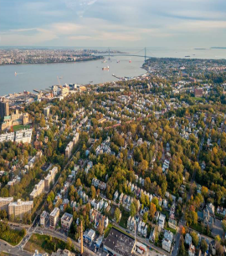
Conclusion
Analysis is performed on the limited data
Re-run the program with different information
Kreuzberg and Friedrichshain also have good number of restaurants which can be explored
As per the neighborhood or restaurant type mentioned like Indian restaurant, analysis can be performed to validate. Venue with low risk and competition can be identified

